Slide 1
IT AT AU - 2019

Slide 2
MIT.au.dk – SELF SERVICE
D06009 | Windows 7 Enterprise | Jens Krasilnikoff | Jens Krasilnikoff | CAS | Historie | hisjk@cas.au.dk | 0 | Jens Krasilnikoff | 0 | 0 | Jens Krasilnikoff |  | 7.649,00 kr.
Official data about your degree programme and enrolment at Aarhus University
Registering for teaching and exams in elective courses
Exam results
Confirmation of enrolment
Applications for admission to Bachelor’s supplementary subjects and Master’s degree programmes at AU
Applications to the board of studies: application for exemption, advance approval etc.
Username: AUID (or civil registration number) Password: Self-chosen password
Guide: http://studerende.au.dk/en/selfservice/mitaudk/

Slide 3
EDUROAM – The wireless network
It is free to use Aarhus University's wireless network, Eduroam.
Username: au(your AUID)@uni.au.dk - for example au123456@uni.au.dk
Password: the same password as for the self-service system (mit.au.dk)
Guide: http://wifi.au.dk/auto_setup_student.php
Have you forgotten your AUID? -> Use AU-guest and create a guest login using Facebook or the like. Then find you AUID at mit.au.dk and log on to Eduroam.

Slide 4
Blackboard – bb.au.dk
Blackboard is the common course and e-learning system at Aarhus University.
If you are registered for a course on mit.au.dk, you will automatically be registered for the course on Blackboard.
The teachers and the Student Counsellors’ Office can communicate with the students through Blackboard.
On the course pages, you can find:
Teaching plans, syllabus lists etc.
Additionally, emails sent to your post.au.dk email are sent through Blackboard, for instance:
Messages from teachers about cancellations or changes in teaching hours/classrooms
Messages from the Student Counsellors’ Office about events and important deadlines

Slide 5
Post.au.dk email
You official AU email address: your student reg. no.@post.au.dk (e.g. 201511111@post.au.dk). Check your email at mit.au.dk or post.au.dk → check it frequently – preferably every day!
Log in using your AUID followed by @uni.au.dk (e.g. au123456@uni.au.dk)
Here you will receive all emails about your degree programme
Information from teachers sent through Blackboard
Information from the Student Counsellors’ Office on important deadlines, registering for elective courses etc.
Manual for getting your post.au.dk email to forward emails to another email address: http://studerende.au.dk/en/selfservice/email/manuals-for-setting-up-mail/
General guide: http://studerende.au.dk/en/selfservice/email/

Slide 6
TIMEtables – your teaching plan
You can find your teaching plans in the timetables.
You can search using your student registration number and find the time and venue for your classes.
Link to the system and user’s guide: http://studerende.au.dk/en/studies/subject-portals/arts/teaching/timetables-arts/
You can also search in “courses” and find the teaching plan for other courses than your own.
There are different websites for the autumn semester and the spring semester.
Link to the autumn semester: http://autumnschedule.au.dk/en/
Link to the spring semester: http://springschedule.au.dk/en/

Slide 7
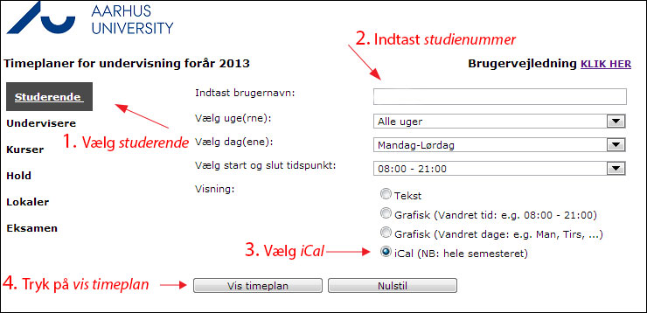
SYNCHRONISE CALENDARS ON YOUR COMPUTER AND SMARTPHONE
Enter your student registration number in the search field (You can find your student reg. no. on your student card)
Select iCal
Click on view timetable
Click on OUTLOOK sync (works on iPhones) or copy-paste the URL into the import feature in your calendar

Slide 8
Studentcard
Activate your student card so it works as a key card for the university’s buildings using this website: http://studerende.au.dk/en/studies/subject-portals/arts/campus/access-to-buildings-and-systems/
You can order a student card through the self-service at mit.au.dk.

Slide 9
PRINTING and copying
In order to print and make copies using the printers at the libraries (AU Library), you must be registered as a user on MyPrint.
You can read more and register as a user here: http://library.au.dk/en/facilities/myprint-print-and-copy/
If in doubt, please ask at the library.

Slide 10
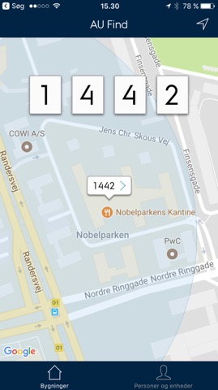
AU FIND – navigation at au
AU FIND is a smartphone application developed for employees, students etc. at Aarhus University.
With “AU Find”, you can use your iPhone or iPad to find contact information for people at Aarhus University, find directions on a map, search for departments, buildings and add people directly to your contacts list.
Download it from the app store.

Slide 11
free Office 365 for students
Aarhus University grants access to Microsoft’s offer of free Office 365 for active students.
As an active student at AU, you can install the Microsoft Office package on up to five units, such as tablets/iPads, smartphones and PCs/Macs. You also get:
Manual for getting the latest OFFICE software on your PC/Mac.
Go to portal.office.com
Your user name is AU<AUID>@uni.au.dk (e.g. AU123456@uni.au.dk). You can find your AUID on mit.au.dk
The password is the same as for mit.au.dk.

Slide 12
Free windows 10 education
As a student at Aarhus University, you can download Windows 10 Education free of charge from Microsoft.
You can find it here: aarhus.onthehub.com
Login: You can log on to ‘onthehub’ using your AUID (e.g. AU123456) and the same password as for mit.au.dk. You can find your AUID on mit.au.dk
Guide: http://studerende.au.dk/en/selfservice/discount-on-software/

Slide 13
FAQ
"AUID or student registration number?"
Students must know their AUID and student registration number. AUID is often used for the self-service systems, while the student reg. no. is often used in assignments/exams.
"When should I use @uni.au.dk?"
Students use uni.au.dk at POST.AU.dk and for connecting to the network.
EDUROAM
"I have forgotten my password."
If you forget your password, you can always log on to mit.au.dk using NEMID. Press the WAYF button on mit.au.dk and then select NEMID as login.
You can reset your password under ‘Personal information’ on the self-service system.

